Slide 1


CAPSTONE PROJECT · SEMESTER VII
Property Value & Infrastructure Impact Estimator
TEAM MEMBERS
Vignesh Rasuri
23WU0101189
A simple, evidence-based view of how development may affect local property values.
Tangudu Santosh
23WU0101178
Thota Abhishek
23WU0101171
GUIDE / MENTOR
Prof. Dileep Kumar M

Slide 2

01 / THE CHALLENGE
Why this problem matters
01
1
Information is scattered
News, government updates, and market values live in different places.
Development can change a
2
Regions are difficult to compare
People do not have one clear view of value, growth, and development.
place. But the evidence is
often
hard to see.
3
Infrastructure changes the outlook
Roads, airports, rail, and industry can affect local demand.
4
Evidence matters
A useful estimate should show its sources and its confidence.
GROUND TRUTH · FROM SCATTERED FACTS TO ONE REGIONAL VIEW

Slide 3

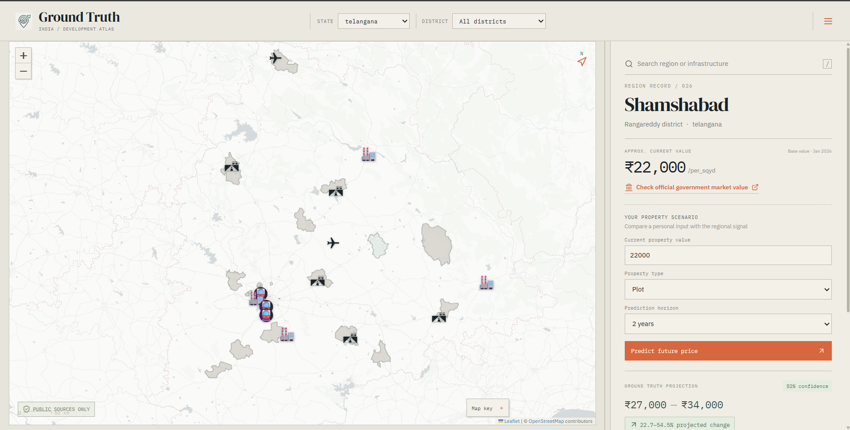
02 / THE PRODUCT
Our solution in one view
One map connects value, development, and evidence.
1
Select a state
Start with the India map and choose the area to explore.
2
Explore a region
See current value, projection, and confidence.
3
Check the evidence
Open news and infrastructure at exact map locations.
4
Run a scenario
Enter a property value and compare a future estimate.
REACT DASHBOARD · MAP FIRST · EVIDENCE LINKED
A CLEAR STARTING POINT FOR EVERY REGION

Slide 4







03 / THE PROCESS
How the system works
1
2
3
4
5
6
Collect
Extract
Match
Score
Store
Display
Gather public news and government records.
Identify projects, places, and development status.
Link each extracted fact to a specific region.
Calculate impact and confidence levels.
Save structured data in PostgreSQL.
Show results in the React dashboard.
GROUND TRUTH · A SEAMLESS JOURNEY FROM RAW DATA TO REGIONAL INSIGHT

Slide 5

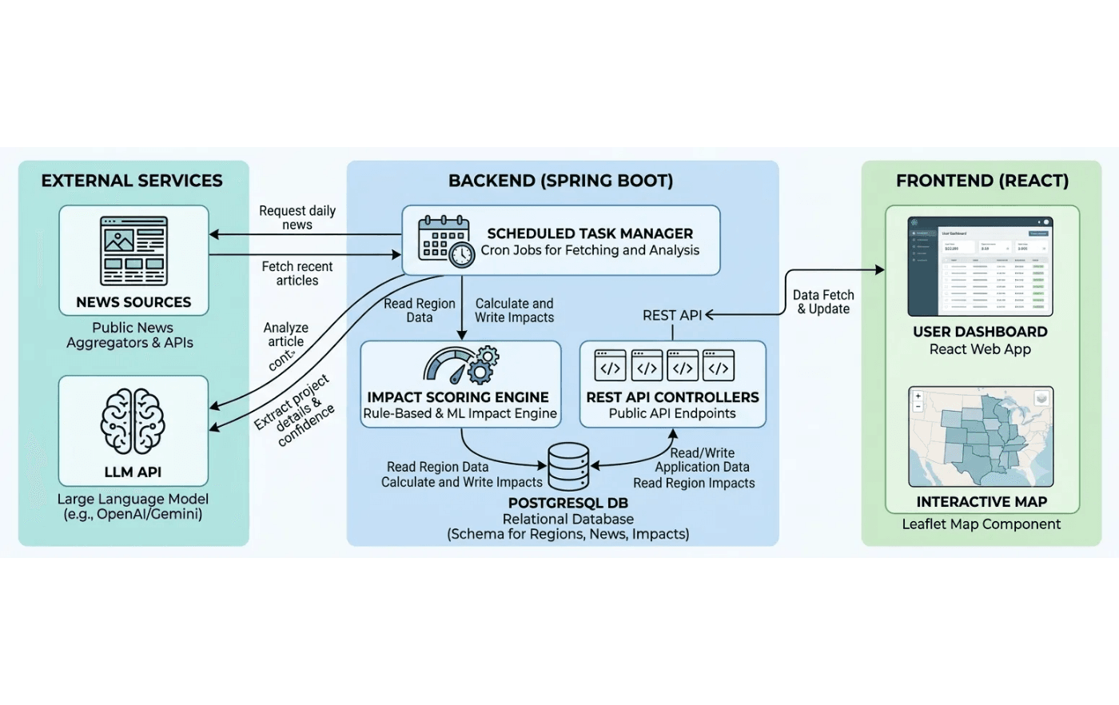
04 / TECHNOLOGY
System Architecture
FRONTEND
React-based dashboard with interactive Leaflet maps and dynamic data panels.
BACKEND
Spring Boot REST API managing data flow, scoring, and scheduled ingestion jobs.
DATABASE
PostgreSQL with PostGIS for spatial queries, region geometry, and news storage.
AI LAYER
ML models for price prediction and LLM-based news fact extraction.
GROUND TRUTH · INTEGRATED DATA PIPELINE

Slide 6
05 / THE INTELLIGENCE
The data and ML
1
Data Collection
2
Feature Engineering
3
Model Training
Historical property values from government and market sources.
•
Combine market trends with local infrastructure impact.
•
Test simple baselines before advanced ML models.
•
Regional features: district, time, and geographic location.
•
Normalize units and dates across all data sources.
•
Train for multiple horizons: 6 months to 5 years.
•
Infrastructure status: planned, developing, or operational.
•
Use time-based testing to prevent data leakage.
•
Evaluate performance on new regions and time periods.
•
The system returns a projected range, a confidence score, the model version, and the key factors driving the estimate.
MODEL OUTPUT
GROUND TRUTH · EVIDENCE-BASED REGIONAL INTELLIGENCE

Slide 7
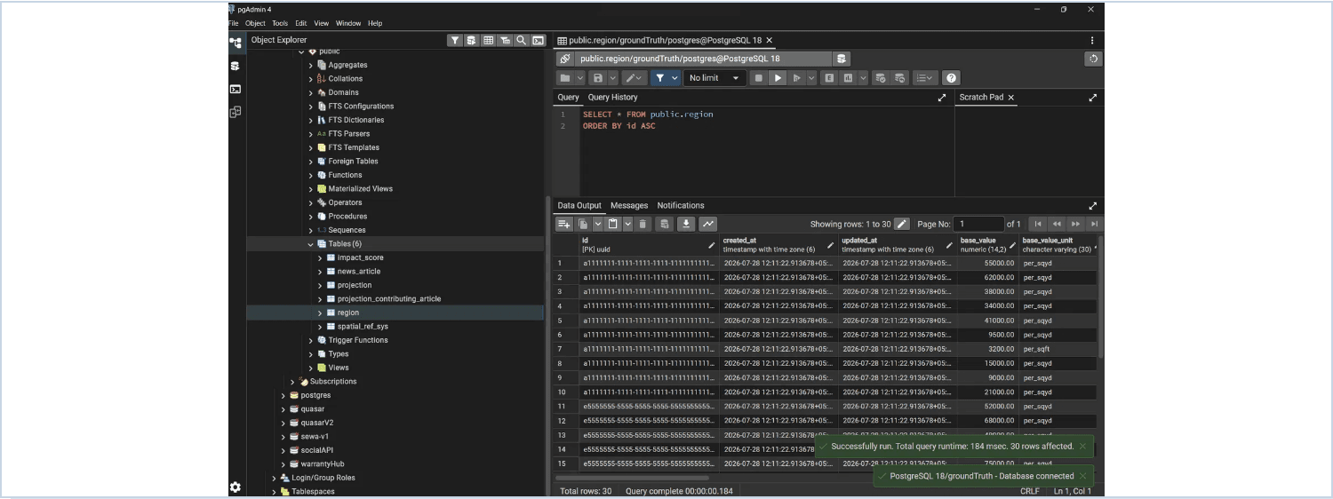
06 / DATA INTELLIGENCE
News becomes structured data
1
2
3
4
5
Fetch
Clean
Extract
Match
Store
Collect news from public sources
Remove duplicates and normalize
Identify projects, places, and dates
Link facts to specific regions
Save as structured database rows
Unstructured articles are transformed into traceable database records for every region.
GROUND TRUTH · EVIDENCE-BACKED REGIONAL INTELLIGENCE

Slide 8
08 / THE ROADMAP
Next steps
Immediate Technical Goals
Strategic Expansion
01
Data & ML Foundation
03
Production Readiness
Build the historical property dataset and train the first baseline ML model for price prediction.
Add database migrations, automated monitoring, and model versioning to ensure system reliability.
02
News Intelligence
04
All-India Rollout
Connect scheduled news extraction to the database and implement the human-in-the-loop review process.
Expand from the current MVP regions to cover all states and major infrastructure projects across India.
"Moving from a functional presentation MVP to a production-ready intelligence platform for regional development."
GROUND TRUTH · FUTURE DEVELOPMENT PATH

Slide 9

From scattered public information to one clear development view.
THANK YOU
GROUND TRUTH · PROPERTY VALUE & INFRASTRUCTURE IMPACT ESTIMATOR

